Slide 1

Mobile Application Development
Welcome
Class: BS(CS)-VII
Sukkur IBA University – Kandhkot Campus
Week - 09
Lecture – 18
Your Facilitator, Adil Khan

Slide 2
Services

Slide 3
Service
A service is an app component that performs long-running operations, usually in the background.
Unlike an Activity, a service doesn't provide a user interface (UI).
Services are defined by the Service class or one of its subclasses.
A service can be started, bound, or both:

Slide 4
Service
A started service is a service that an app component starts by calling startService().
Use started services for tasks that run in the background to perform long-running operations.
A bound service is a service that an app component binds to itself by calling bindService().
Use bound services for tasks that another app component interacts with to perform interprocess communication (IPC). For example, a bound service might handle network transactions, perform file I/O, play music, or interact with a database.
Offers a client-server interface that allows components to interact with the service. Clients send requests and get results.

Slide 5
Services and threads
A service runs in the main thread of its hosting process—the service doesn't create its own thread and doesn't run in a separate process unless you specify that it should.
If your service is going to do any CPU-intensive work or blocking operations (such as MP3 playback or networking), create a new thread within the service to do that work.
By using a separate thread, you reduce the risk of the user seeing "application not responding" (ANR) errors, and the app's main thread can remain dedicated to user interaction with your activities.

Slide 6
Services
To implement any kind of service in your app, do the following steps:
Declare the service in the manifest.
Extend a Service class such as IntentService and create implementation code.
Manage the service lifecycle.

Slide 7
Declaring services in the manifest
As with activities and other components, you must declare all services in your Android manifest.
To declare a service, add a <service> element as a child of the <application> element. For example:
<manifest ... >
...
<application ... >
<service android:name=".ExampleService"
android:exported="false" />
...
</application>
</manifest>

Slide 8
Declaring services in the manifest
To block access to a service from other apps, declare the service as private.
To do this, set the android:exported attribute to false.
This stops other apps from starting your service, even when they use an explicit intent.

Slide 9
Declaring services in the manifest
An app component such as an Activity calls startService() and passes in an Intent. The Intent specifies the service and includes any data for the service to use.
The system calls the service's onCreate() method and any other appropriate callbacks on the main thread. It's up to the service to implement these callbacks with the appropriate behavior, such as creating a secondary thread in which to work.
The system calls the service's onStartCommand() method, passing in the Intent supplied by the client in step 1. (The client in this context is the app component that calls the service.)

Slide 10
Declaring services in the manifest
Once started, a service can run in the background indefinitely, even if the component that started it is destroyed.
Usually, a started service performs a single operation and does not return a result to the caller. For example, it might download or upload a file over the network.
When the operation is done, the service should stop itself by calling stopSelf(), or another component can stop it by calling stopService().

Slide 11
Declaring services in the manifest
For instance, suppose an Activity needs to save data to an online database. The Activity starts a companion service by passing an Intent to startService(). The service receives the intent in onStartCommand(), connects to the internet, and performs the database transaction. When the transaction is done, the service uses stopSelf() to stop itself and is destroyed. (This is an example of a service you want to run in a worker thread instead of the main thread.)

Slide 12
Service lifecycle
The lifecycle of a service is simpler than the Activity lifecycle.
However, it's even more important that you pay close attention to how your service is created and destroyed.
Because a service has no UI, services can continue to run in the background with no way for the user to know, even if the user switches to another app.
This situation can potentially consume resources and drain the device battery.

Slide 13
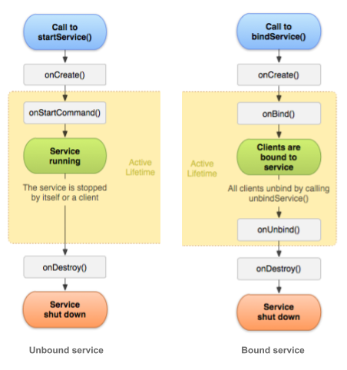
Service lifecycle

Slide 14
Service lifecycle
A bound service exists only to serve the app component that's bound to it, so when no more components are bound to the service, the system destroys it.
Bound services don't need to be explicitly stopped the way started services do (using stopService() or stopSelf()).

Slide 15
Thank you!
Any Questions???

